Slide 1



Enabling Smarter Cities through Internet of Things, Web of Data & Citizen Participation Reunión Red Open City Data 17 de Febrero de 2016 Dr. Diego López-de-Ipiña González-de-Artaza dipina@deusto.es http://paginaspersonales.deusto.es/dipina http://www.morelab.deusto.es

Slide 2
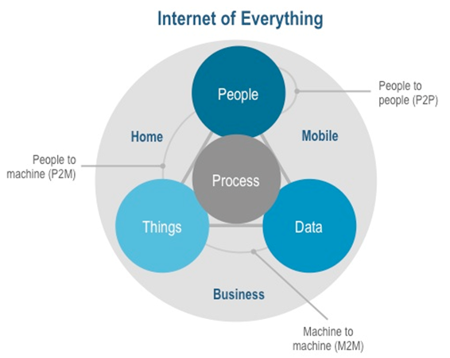
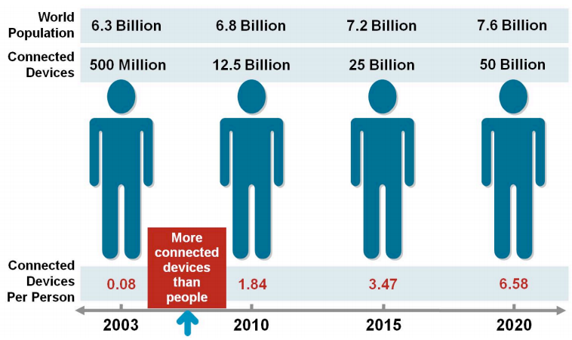
Internet of Things (IoT) Promise
There will be around 25 billion devices connected to the Internet by 2015, 50 billion by 2020
A dynamic and universal network where billions of identifiable “things” (e.g. devices, people, applications, etc.) communicate with one another anytime anywhere; things become context-aware, are able to configure themselves and exchange information, and show “intelligence/cognitive” behaviour

Slide 3
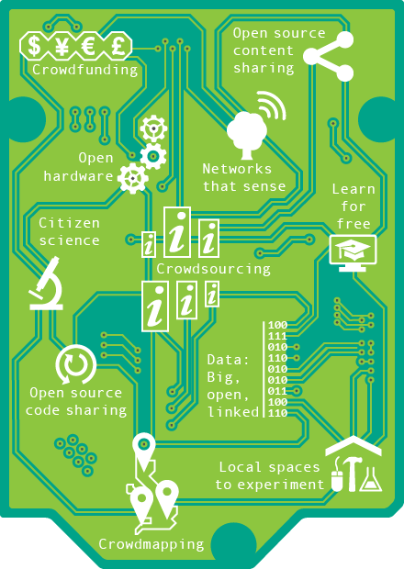
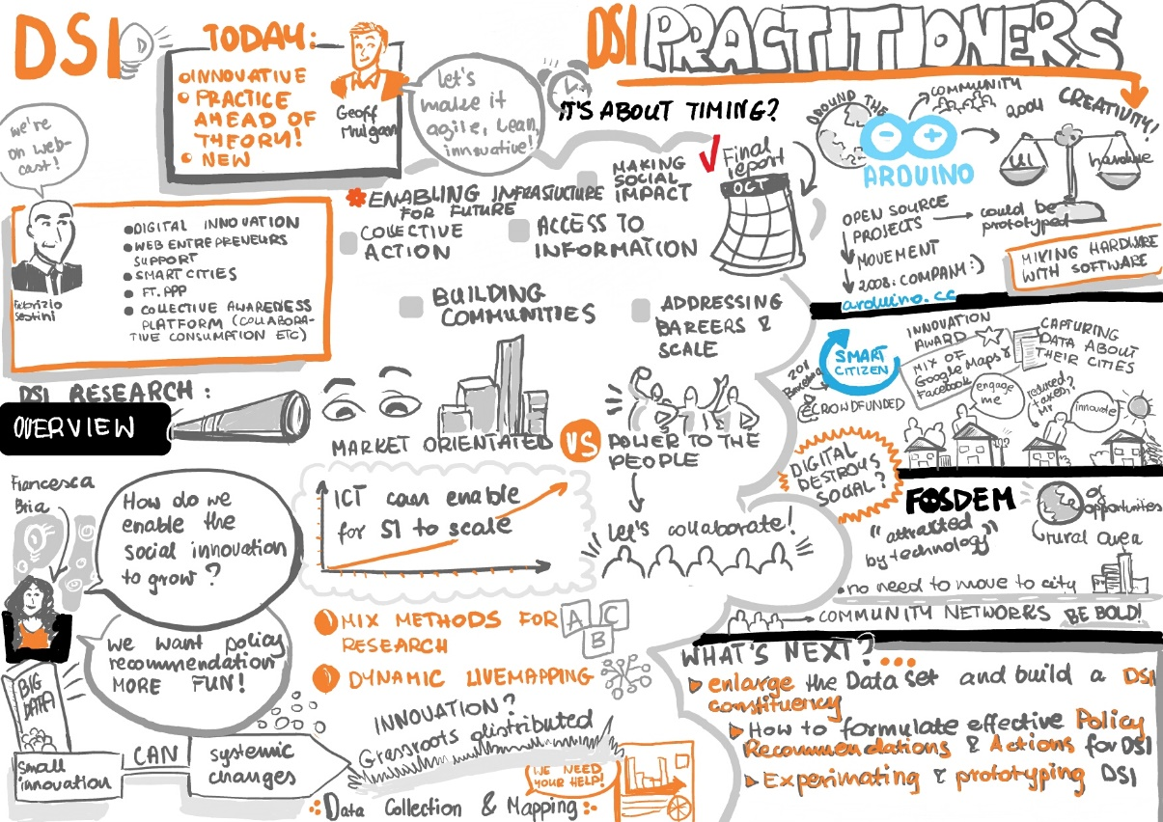
Social Open Innovation
Novel solution to a social problem that is more effective, efficient, sustainable, or just than current solutions.
New ideas (products, services and models) that simultaneously meet social needs and create new social relationships
Notes:
Collective Awareness Platforms for Sustainability and Social Innovation

Slide 4
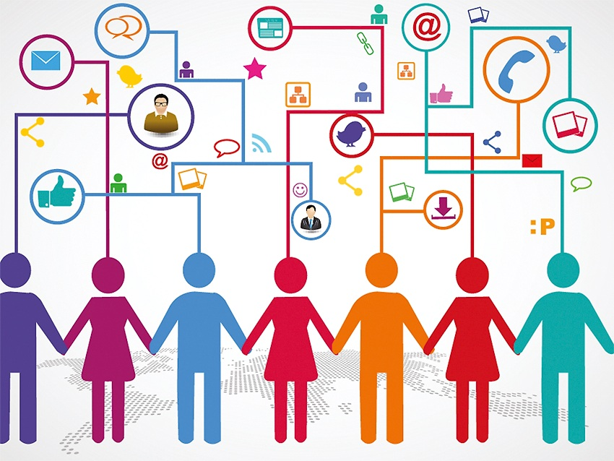
CAPS: Collective-awareness Platforms for Sustainability and Social Innovation
Aims at designing and piloting online platforms creating awareness of sustainability problems and offering collaborative solutions based on networks (of people, of ideas, of sensors), enabling new forms of social innovation.
Examples:
Open Democracy, Open Policy Making
Collaborative/Shared Economy
Collaborative making → co-creation
Notes:
Collective Awareness Platforms for Sustainability and Social Innovation

Slide 5
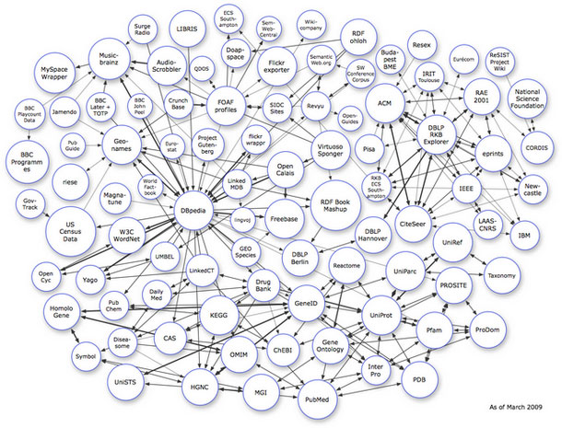
Linked Data
“A term used to describe a recommended best practice for exposing, sharing, and connecting pieces of data, information, and knowledge on the Semantic Web using URIs and RDF.“
Allows to discover, connect, describe and reuse all sorts of data
Fosters passing from a Web of Documents to a Web of Data
In September 2011, it had 31 billion RDF triples linked through 504 millions of links
Thought to open and connect diverse vocabularies and semantic instances, to be used by the Semantic community
URL: http://linkeddata.org/

Slide 6
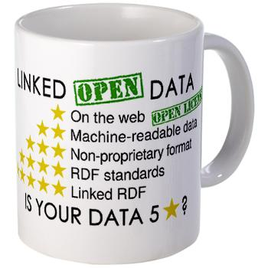
Linked Data Principles
Uses URIs to identify things
Uses HTTP URIs to enable those things to be dereferenced by both people and user agents
Provides useful info (structured description and metadata) about a thing/concept referenced by an URI
Includes links to other URIs to improve related information discovery in the web

Slide 7
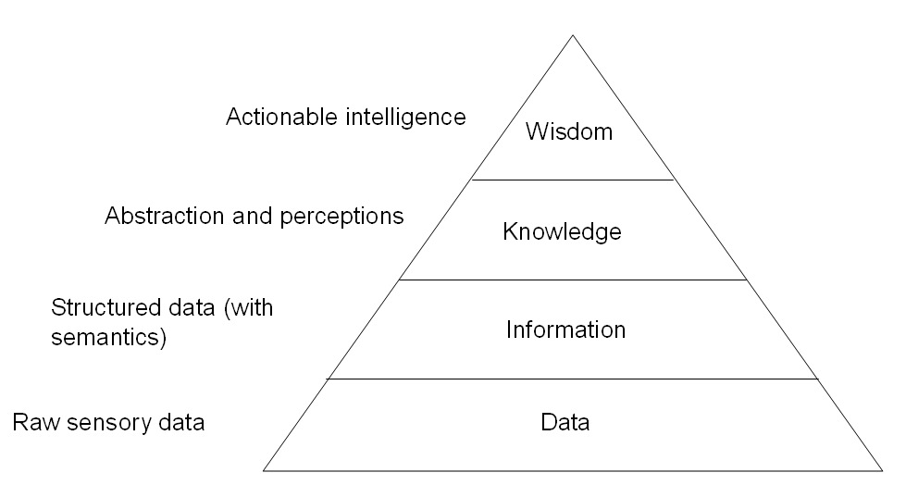
Actionable Knowledge from Linked Data
Don’t care about the data sources (sensors) care about knowledge extracted from their data correlation & interpretation!
Data is captured, communicated, stored, accessed and shared from the physical world to better understand the surroundings
Sensory data related to different events can be analysed, correlated and turned into actionable knowledge
Application domains: e-health, retail, green energy, manufacturing, smart cities/houses

Slide 8
What is a Smart Sustainable City?
A smart sustainable city is an innovative city that uses information and communication technologies and other means to improve quality of life, efficiency of urban operation and services, and competitiveness, while ensuring that it meets the needs of present and future generations with respect to economic, social and environmental aspects
https://itunews.itu.int/en/5215-What-is-a-smart-sustainable-city.note.aspx

Slide 9
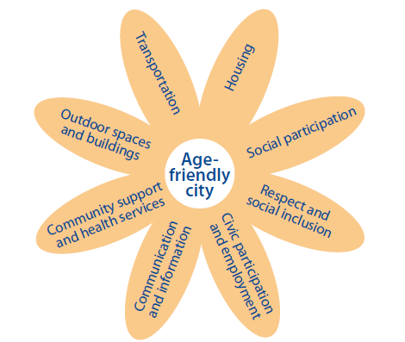
Age-friendly Smarter Cities
The main attribute of a Smart City is efficiency
An Age-friendly city is an inclusive and accessible urban environment that promotes active ageing
The main attributes of an Ambient Assisted (Smarter) City are:
Livable
Accessible
Healthy
Inclusive
Participative
[WHO Global Network of Age-friendly Cities]
Notes:
Livable: safety/crime, international connectivity, climate/sunshine, quality of architecture, public transportation, tolerance, environmental issues and access to nature, urban design, business conditions, pro-active policy developments and medical care.
– best living conditions
World Health Organization is also promoting : A healthy city is one that is continually creating and improving those physical and social environments and expanding those community resources which enable people to mutually support each other in performing all the functions of life and developing to their maximum potential. http://www.who.int/healthy_settings/types/cities/en/

Slide 10
The need for Participative Cities
Not enough with the traditional resource efficiency approach of Smart City initiatives
“City appeal and dynamicity” will be key to attract and retain citizens, companies and tourists
Only possible by user-driven and centric innovation:
The citizen should be heard, EMPOWERED!
Urban apps to enhance the experience and interactions of the citizen, by taking advantage of the city infrastructure
The information generated by cities and citizens must be linked and processed
How do we correlate, link and exploit such humongous data for all stakeholders’ benefit?
We should start talking about Big (Linked) Data

Slide 11
Urban Intelligence / Analytics
Broad Data aggregates data from heterogeneous sources:
Open Government Data repositories
User-supplied data through social networks or apps
Public private sector data or
End-user private data
Humongous potential on correlating and analysing Broad Data in the city context:
Leverage digital traces left by citizens in their daily interactions with the city to gain insights about why, how and when they do things
We can progress from Open City Data to Open Data Knowledge
Energy saving, improve health monitoring, optimized transport system, filtering and recommendation of contents and services

Slide 12
Smarter Cities
Smarter Cities → cities that do not only manage their resources more efficiently but also are aware of the citizens’ needs.
Human/city interactions leave digital traces that can be compiled into comprehensive pictures of human daily facets
Analysis and discovery of the information behind the big amount of Broad Data captured on these smart cities deployment
Smarter Cities= Internet of Things + Linked Data + citizen participation through Smartphones + Urban Analytics

Slide 13
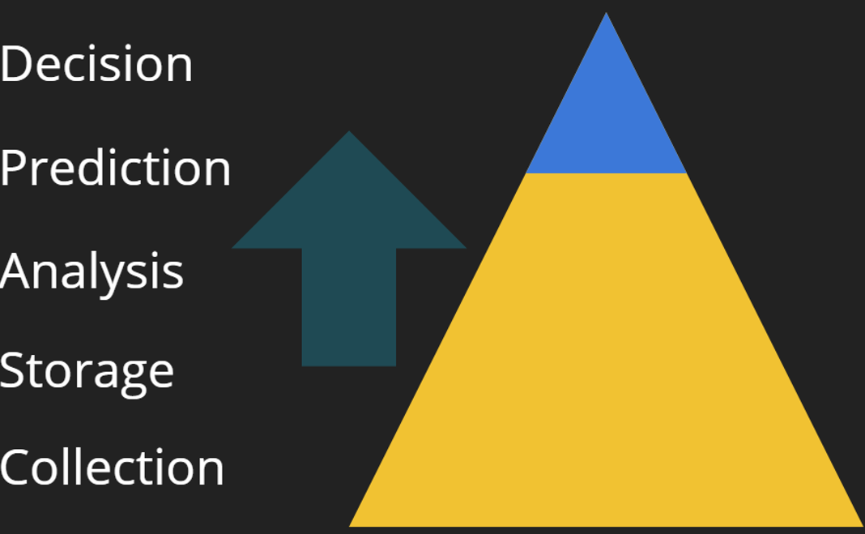
Data challenges of Smart Cities
Data coverage and access (openness)
Data integration and interoperability (data standards) – overcoming the silo and resistance to change
Data quality and provenance: veracity (accuracy, fidelity), uncertainty, error, bias, reliability, calibration, lineage
Quality, veracity and transparency of data analytics
Data interpretation and management issues
Paradigm shift towards data-driven decision making
Security and privacy: stem data breaches and fraud
Skills and organizational capabilities and capacities

Slide 14
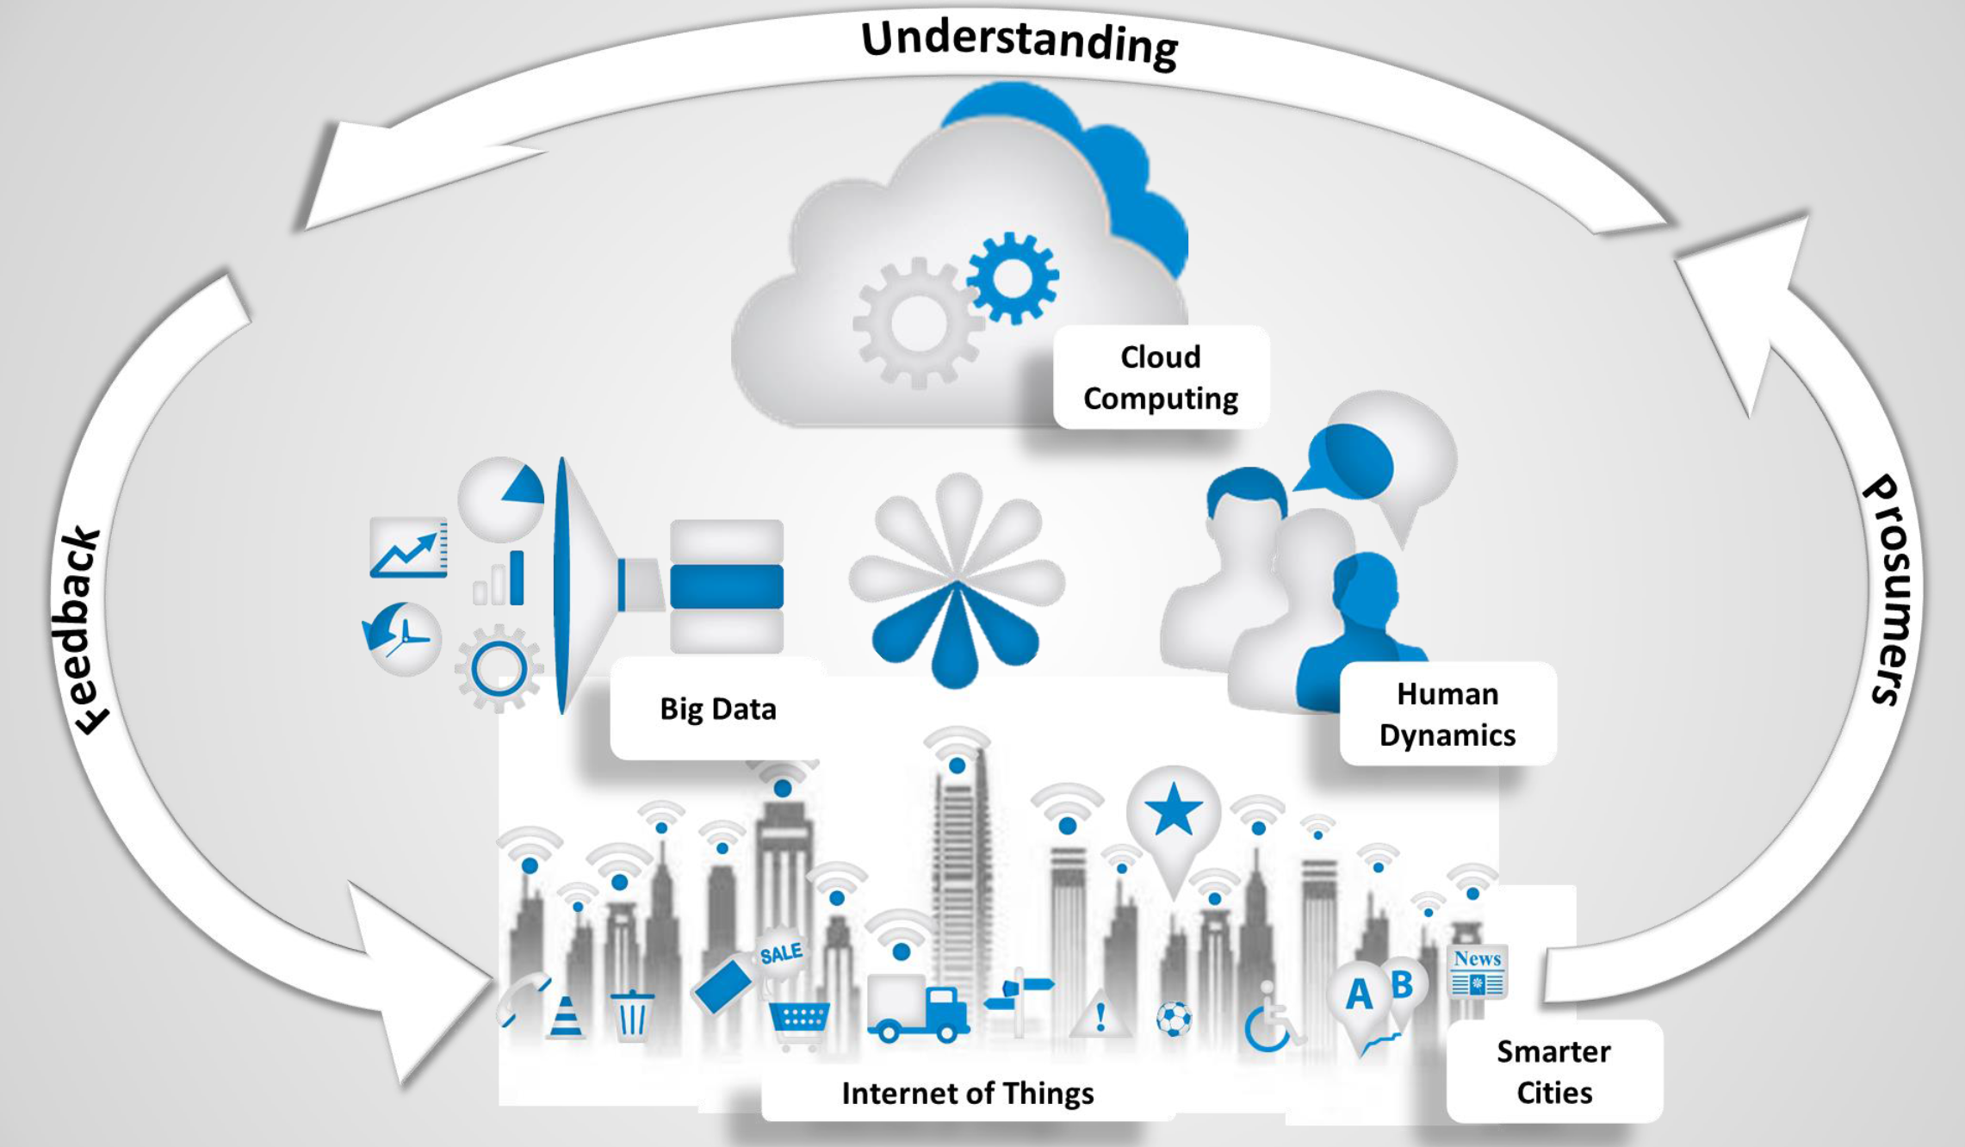
Analytics in the Smart City: Data-driven decision making

Slide 15
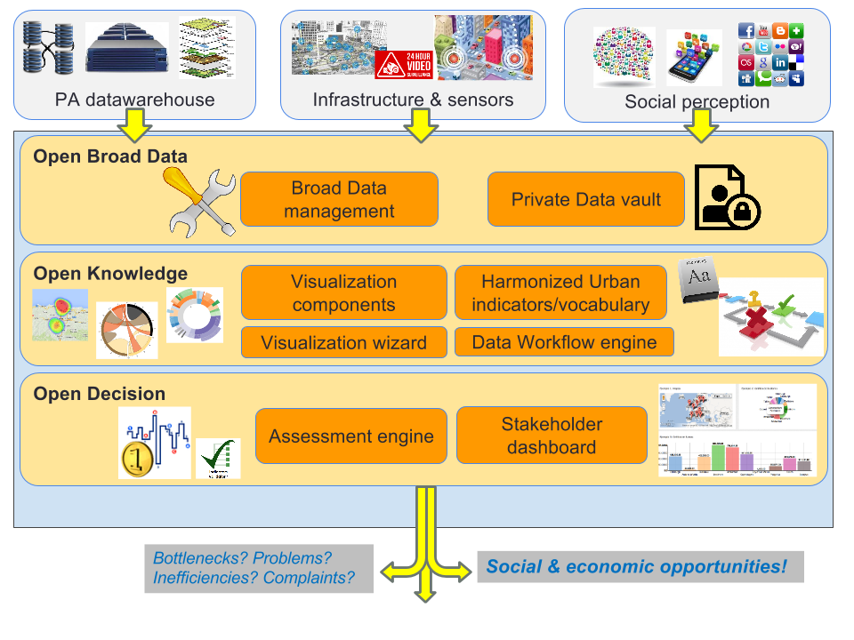
From Open Data to Open Knowledge

Slide 16

IES Cities Project
European CIP project
2013-2016, Zaragoza & Majadahonda involved
The IES Cities project promotes user-centric mobile micro-services that exploit open data and generate user-supplied data
Hypothesis: Users may help on improving, extending and enriching the open data in which micro-services are based
Its platform aims to:
Enable user supplied data to complement, enrich and enhance existing datasets about a city
Facilitate the generation of citizen-centric apps that exploit urban data in different domains
http://iescities.eu

Slide 17
IES Cities Stakeholders
Citizens:
Users collaborate in the definition of the digital entity of the city.
Citizen produce and consumes contents (super-prosumer concept).
SMEs:
IES Cities will allow the creation of services benefiting the local businesses.
ICT-developing companies:
The platform will enable the chance to create new apps and services based on user needs, bringing new possibilities and added value.
Public administration:
The interaction with the users will enable them to improve and foster the use of their deployed sensors in urban areas and open databases

Slide 18
IES Cities Objectives
To create a new open-platform adapting the technologies and over taking the knowledge from previous initiatives.
To validate and test a set of predefined urban apps across the cities.
To validate, analyse and retrieve technical feedback from the different pilots in order to detect and solve the major incidences of the technical solutions used in the cities.
To adequately achieve engagement of users in the pilots and measure their acceptability during the validations.
To maximize the impact of the project through adequate dissemination activities and publication of solutions upon a Dual-license model.

Slide 19
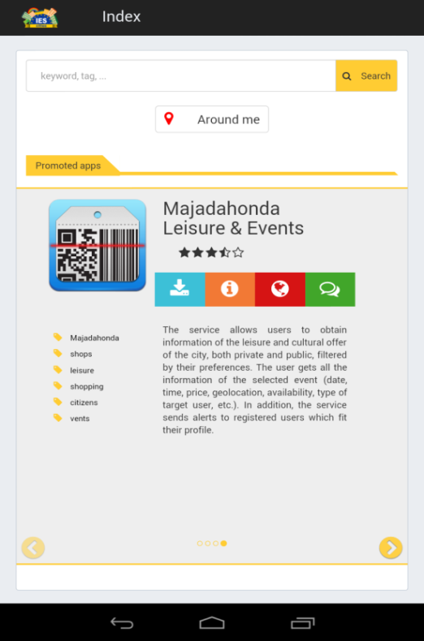
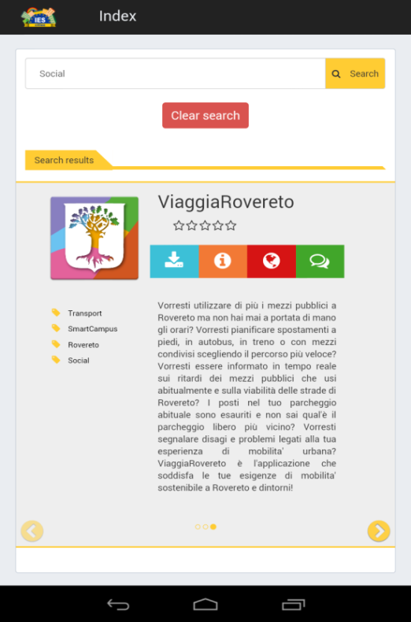
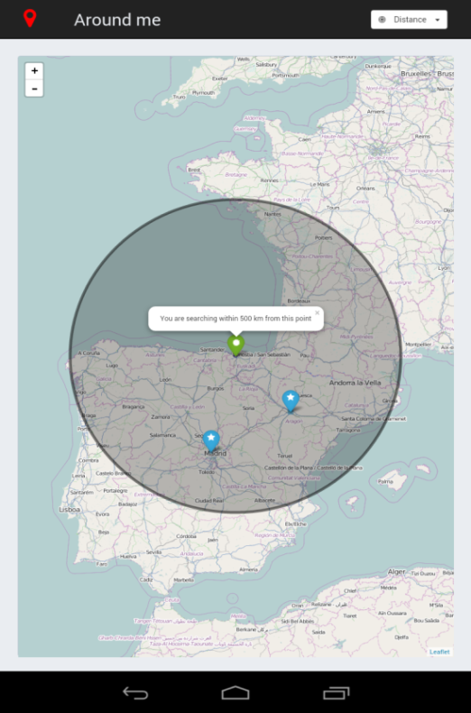
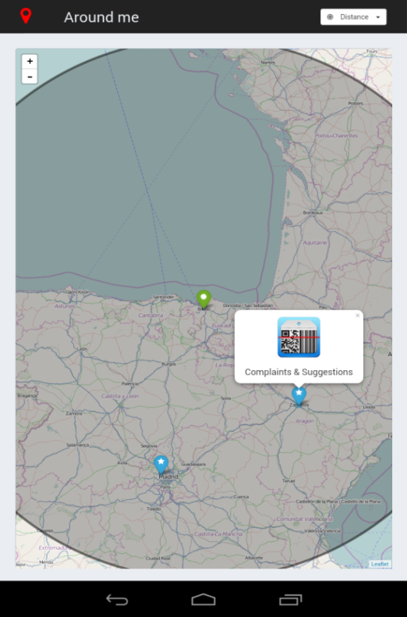
IES Cities Player
17 apps in Google Play: https://play.google.com/store/search?q=IESCities&c=apps

Slide 20
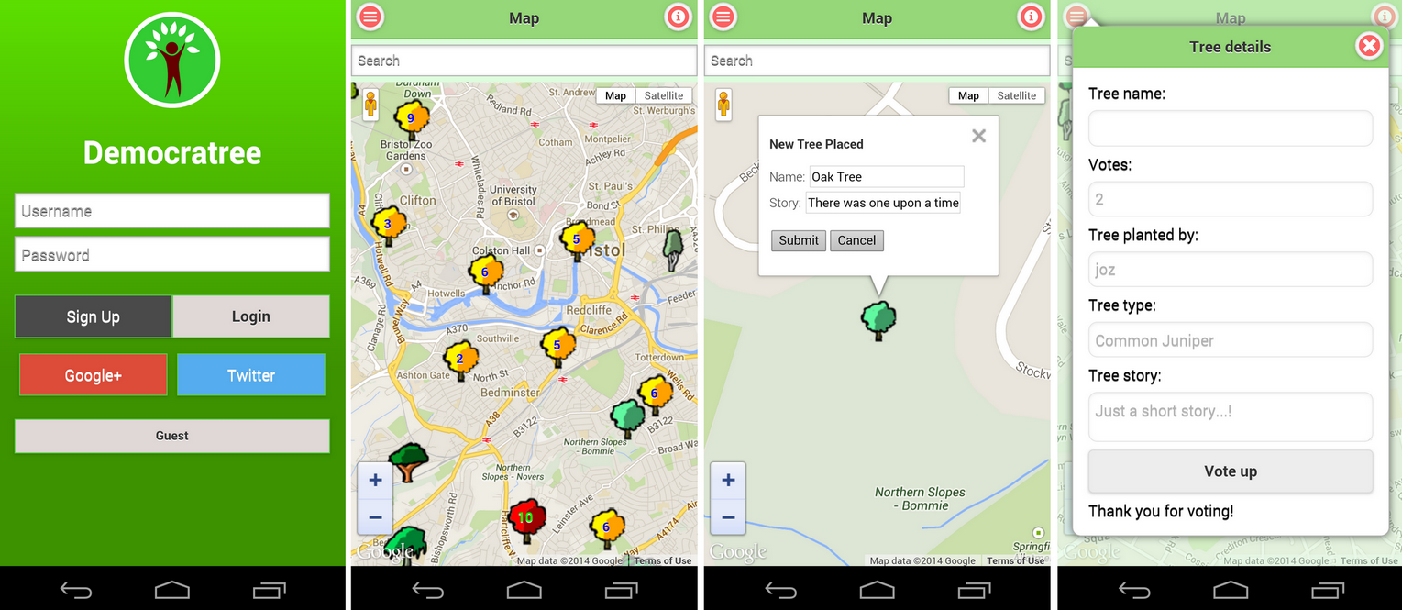
Bristol’s Democratree App

Slide 21
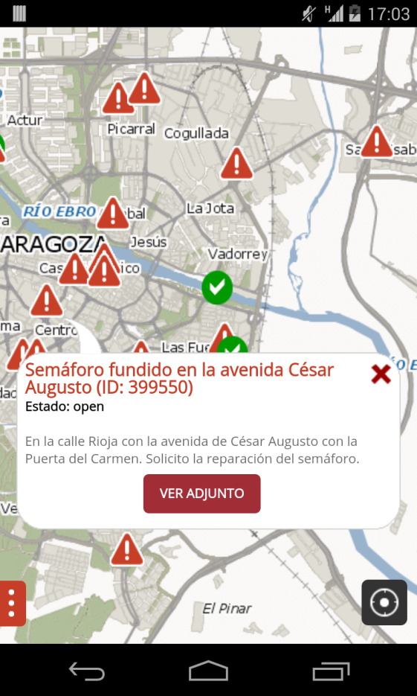
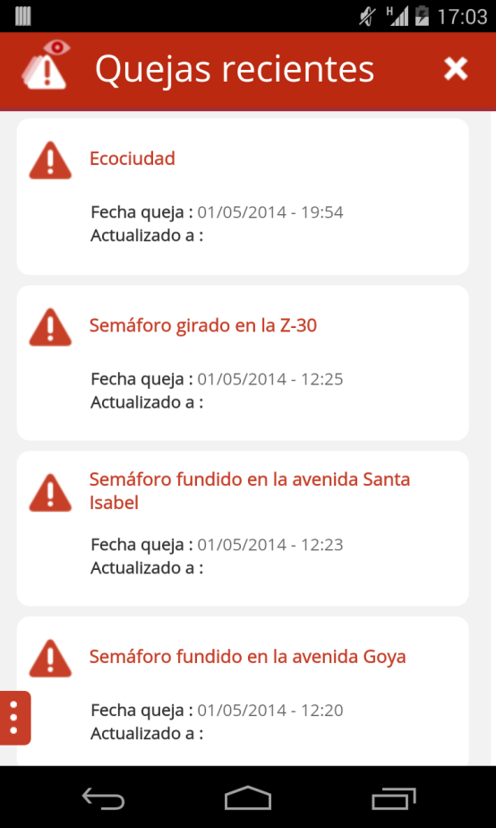
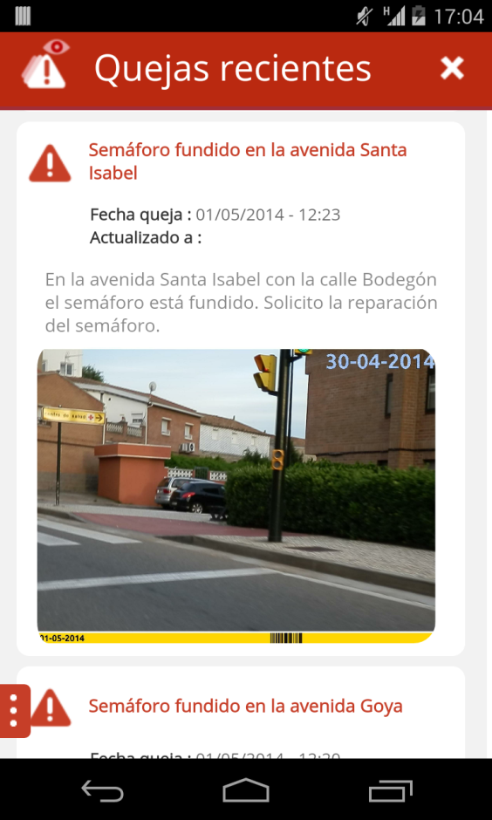
Zaragoza’s Your Opinion Matters

Slide 22
Relación con Open City Data
Hemos explorado cómo mezclar datos generados por usuarios con datos públicos, donde los resultados en consultas se mezclan pero los datasets no
Usado datos públicos de Bristol, Zaragoza, Majadahonda y Rovereto → ciudades muy distintas con diferentes grados de madurez en el ofrecimiento de datos abiertos
Su mayor virtud es que un desarrollador web sólo debe centrarse en parte cliente, haciendo que el hosting de datasets públicos y los creados por la propia aplicación sean gestionados por la solución.
Aparte de dataset hosting and querying la solución también permite generar logs para medir usabilidad de la solución
Hemos creado solución http://iescities.com, donde ciudades pueden alojar datasets junto con JSON mapping que permite su explotación a través de API Query Mapper
Swagger API to access functionality of the Project at: https://iescities.com/IESCities/swagger/
Liberaremos como Open Source bajo licencia Apache 2 al final de este mes el código del proyecto

Slide 23
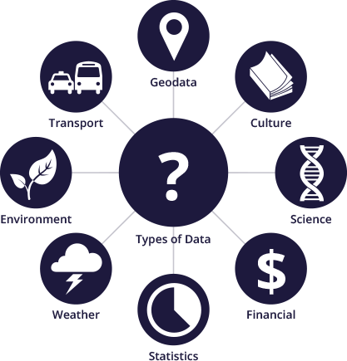
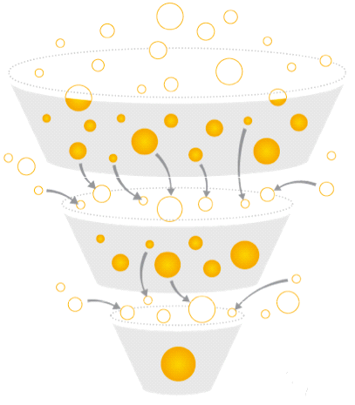
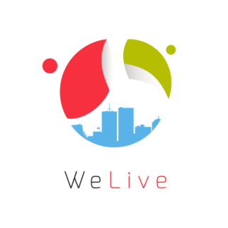
What´s WeLive (I)
H2020 project
2015-2017,
Bilbao council involved
A novel We-Government ecosystem of tools (Live) that is easily deployable in different PA and which promotes co-innovation and co-creation of personalised public services through public-private partnerships and the empowerment of all stakeholders to actively take part in the value-chain of a municipality or a territory
Open Data
Open Services
Open Innovation
http://welive.eu

Slide 24
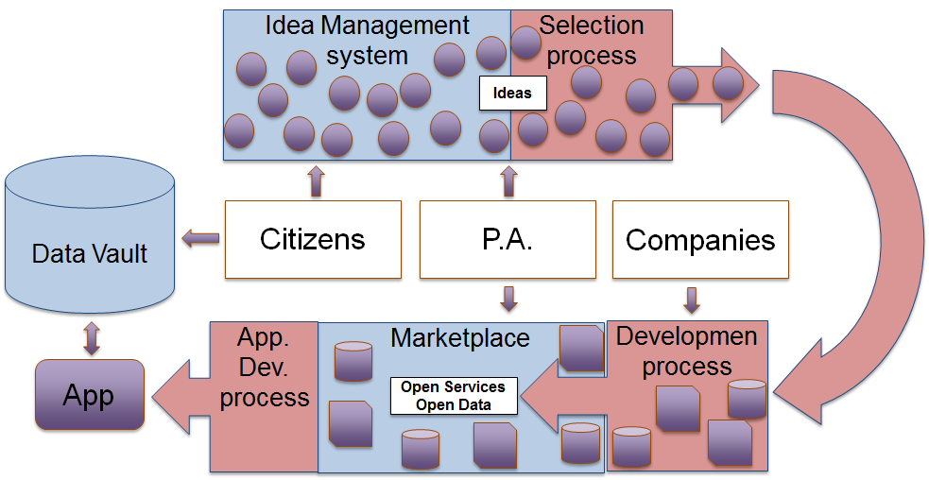
What´s WeLive (II)
Stakeholder Collaboration + Public-private Partnership →
IDEAS >> APPLICATIONS >> MARKETPLACE
1
WeLive offers tools to transform the needs into ideas
2
Tools to select the best Ideas and create the B. Blocks
3
A way to compose the Building Blocks into mass market Applications which can be exploited through the marketplace

Slide 25
WeLive proposes…
Transform the current e-government approach into…
WeLive Open and Collaborative Government Solution = We-government + t-government + I-government + m-government
We-
t-
l-
m-
All stakeholders are treated as peers and prosumers
Providing Technology tools to create public value
To do more with less by involving other players and the PA as orchestrator
Utilisation of mobile tech. for public services delivery

Slide 26
Key pillars
Open Data
WeLive provides an open data toolset which eases to capture, transform, adapt, link, store, publish and search for data.
Open Services
WeLive provides an open services framework based on B. blocks and app templates. These will be easily combined to give place to new services
1
2
Open Innovation
WeLive focuses on how to pass from innovation to adoption, by democratizing the creation process and fostering pp partnership.
User-centric Services
WeLive enables personalization of public service apps based on user profile and context though the Citizen Data Vault, Visual composer and WeLive decision engine element.
3
4

Slide 27
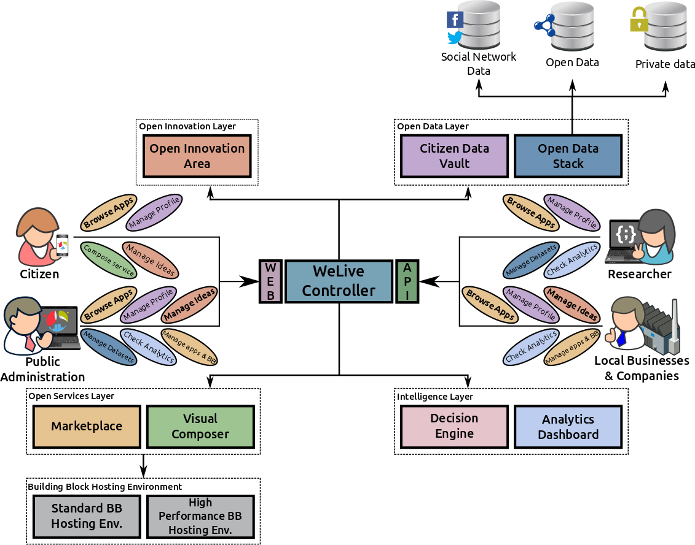
WeLive Vision/Architecture

Slide 28
Relación con Open City Data
Lo innovador de este proyecto es combinar Open Data + Open Services + Open Innovation
Hemos adaptado CKAN 4 para dar lugar a Open Data Stack
Estamos interesados en soportar datasets heterogéneos, provenientes de diferentes fuentes. Es decir, Open Data, datos de redes sociales, etc.
Hemos desarrollado varios Data Harvesters y Verifiers
Integrando con otros componentes de la solución como varios recomendadores y WeLive Marketplace
En este Marketplace publicamos artefactos (datasets, building blocks y apps) que están descritos en vocabulario Linked USDL
Realidad es que muchos datos públicos no son útiles para hacer las aplicaciones que demanda la ciudadanía.
Consecuencia hay que generar nuevos datasets con las contribuciones de los usuarios ejecutando apps
Software desarrollado:
Nuestro ODS está disponible en: http://apps.morelab.deusto.es/ods/
Serán hechas públicas nuestras extensiones al final del proyecto, estamos en M13 del proyecto de 36 meses
APIs del proyecto disponibles en: https://dev.welive.eu/dev/swagger

Slide 29
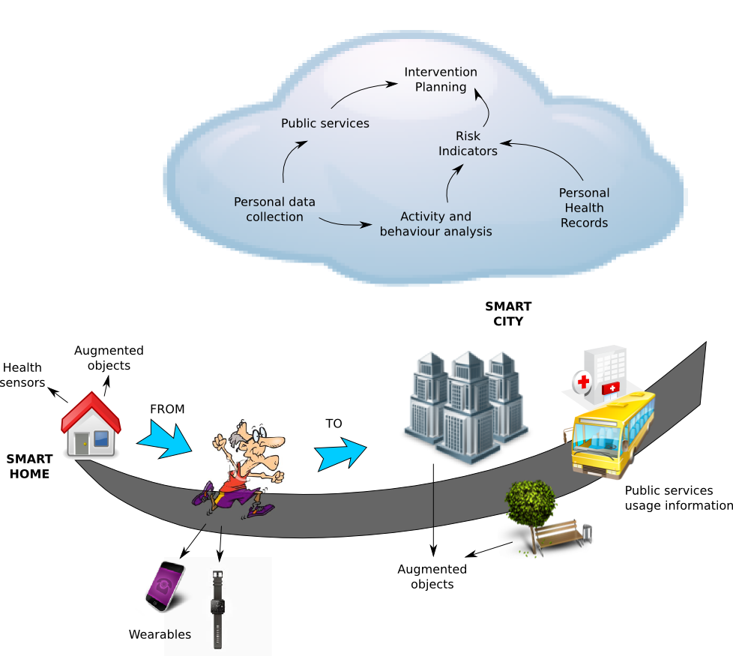
City4Age: Elderly-friendly City services for active and healthy ageing
H2020 project 2016-2018, PHC 21, Madrid is involved
Aims to act as a bridge between the European Innovation Partnerships (EIP) on Smart Cities and Communities & Active and Healthy Ageing (EIP AHA)
Demonstrate that Cities play a pivotal role in the unobtrusive collection of “more data”and with “increased frequency” for comprehending individual behaviours and improving the early detection of risks to address MCI (Mild Cognitive Impairment)
Notes:
European Innovation Partnerships

Slide 30
Relación con Open City Data
En este proyecto trabajaremos, empezó en Diciembre, en modelar actividades de los ancianos en la ciudad y detección de cambios de patrones
Además, daremos lugar a datasets que puedan luego ser usados por la comunidad científica
El principal desafío es como correlacionar datos públicos con datos personales → personal data management
Hay que cruzar datos relativamente estáticos (profiles, personal health records con datos muy dinámicos)
Objetivo es dar soporte a ciudadadanos ancianos en sus actividades cotidianas en la ciudad

Slide 31
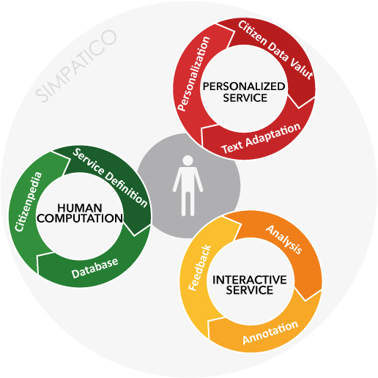
SIMPATICO
Addresses the need to offer a more efficient and more effective experience to companies and citizens in their daily interaction with Public Administration (PA)
Providing a personalized delivery of e- services based on advanced cognitive system technologies and by promoting an active engagement of people for the continuous improvement of the interaction with these services.
H2020 project
2016-2018, EURO6,
Xunta Galicia is involved

Slide 32
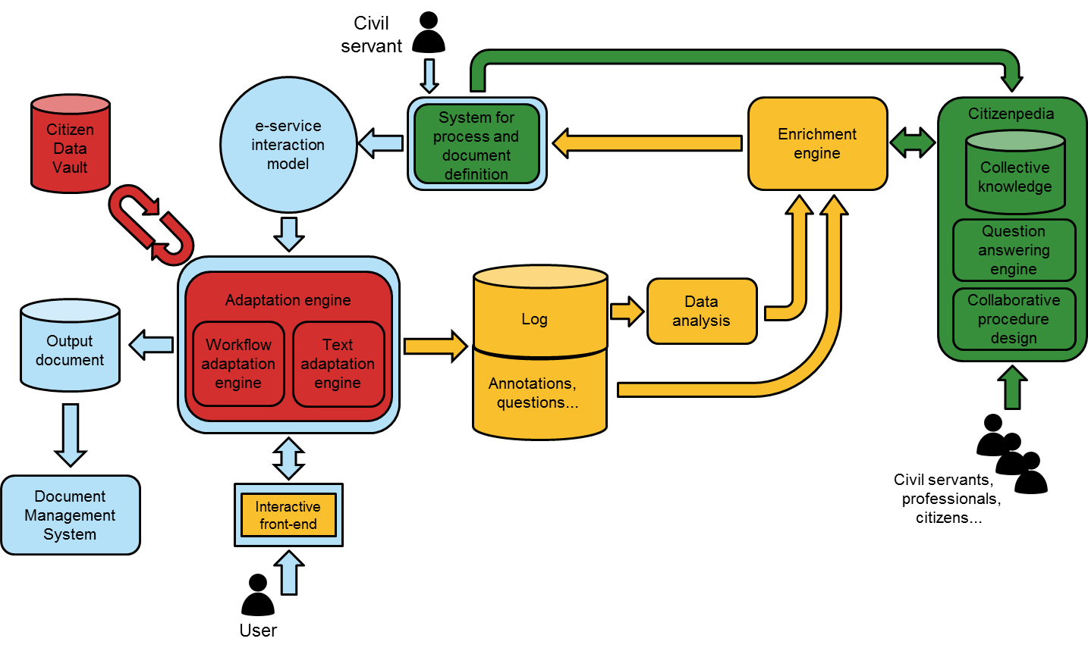
PA traditional e-services vs. SIMPATICO approach

Slide 33
Relación con Open City Data
Empieza en Marzo
Afronta el desafío de la anotación y recomendación (sugerencias) asociadas al consumo de servicios públicos
Objetivo es crear una Citizenpedia con estas anotaciones contextuales de diferentes partes de un proceso/servicio con la administración pública
Desafío combinar Machine and Crowd Intelligence

Slide 34

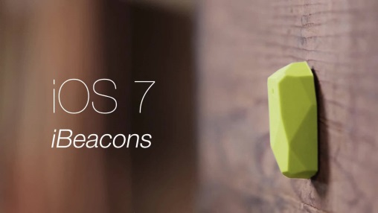
MORElab has a dream … the citizen-empowered inclusive City
Smart Cities must ensure social equity, economic viability and environmental sustainability, enabled by:
IoT: Smart Objects, e.g. enabling technology for inclusive cities which allows to collect data, e.g. people transiting through a given area
Web of Data: Open Data from a given council should be linked to real-time data gathered by sensor data (physical) and prosumed data by users (virtual sensors) → BROAD DATA
Citizen participation: smartphones running Location-aware Open Data apps which recommend to surrounding citizens and visitors according to their profile and capabilities
User-conscious apps should adapt to the capabilities of different users, their devices and current context

Slide 35
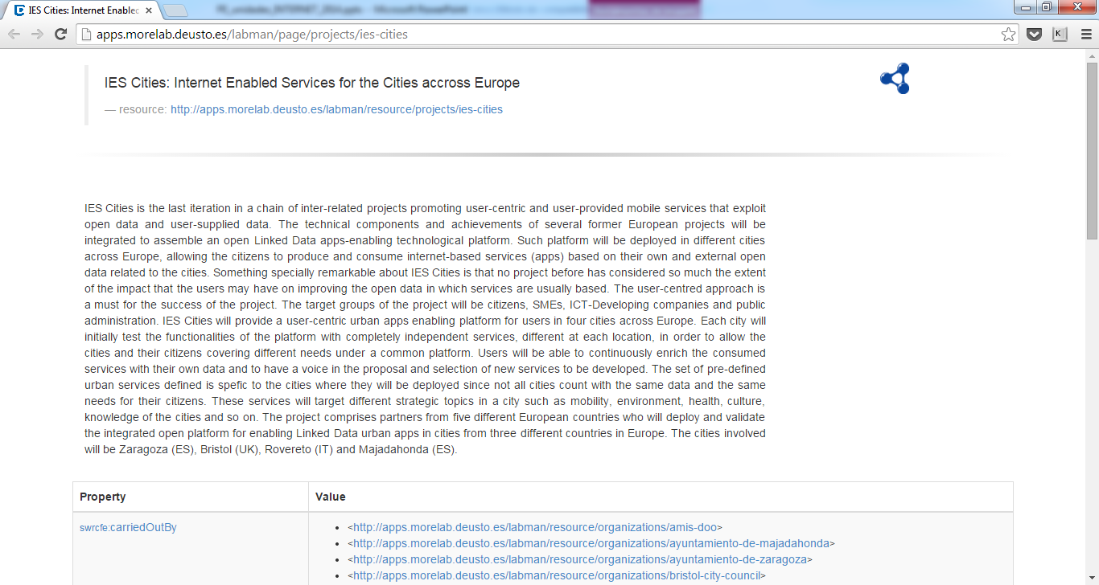
Web of Data: MORElab Group Dataset

Slide 36
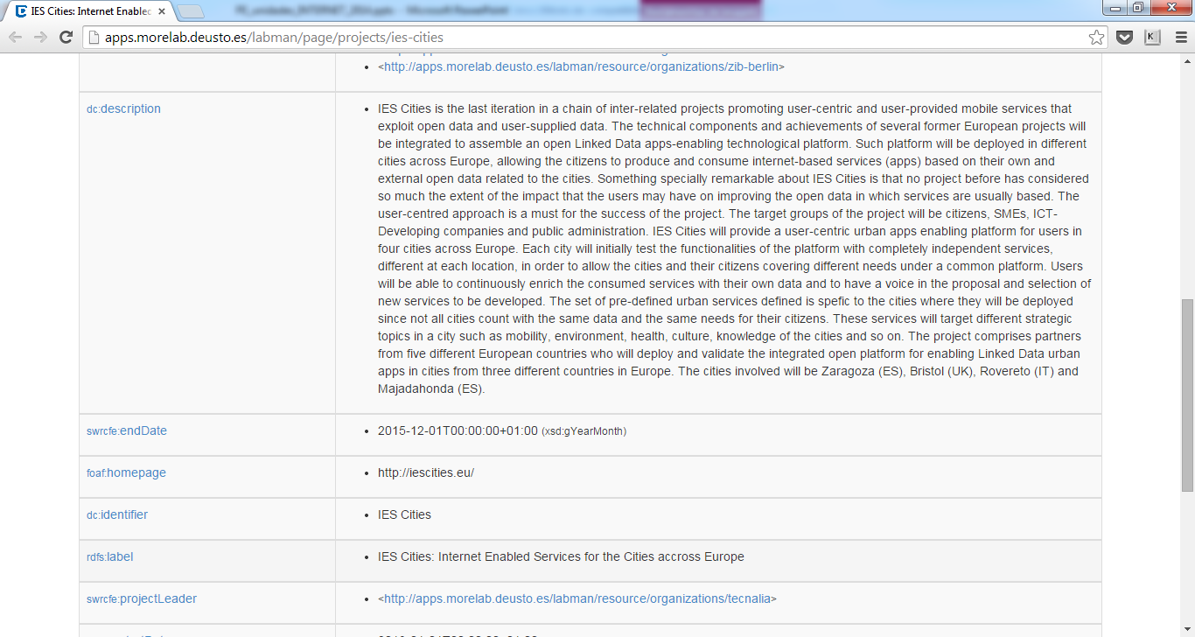
Web of Data: MORElab Group Dataset

Slide 37
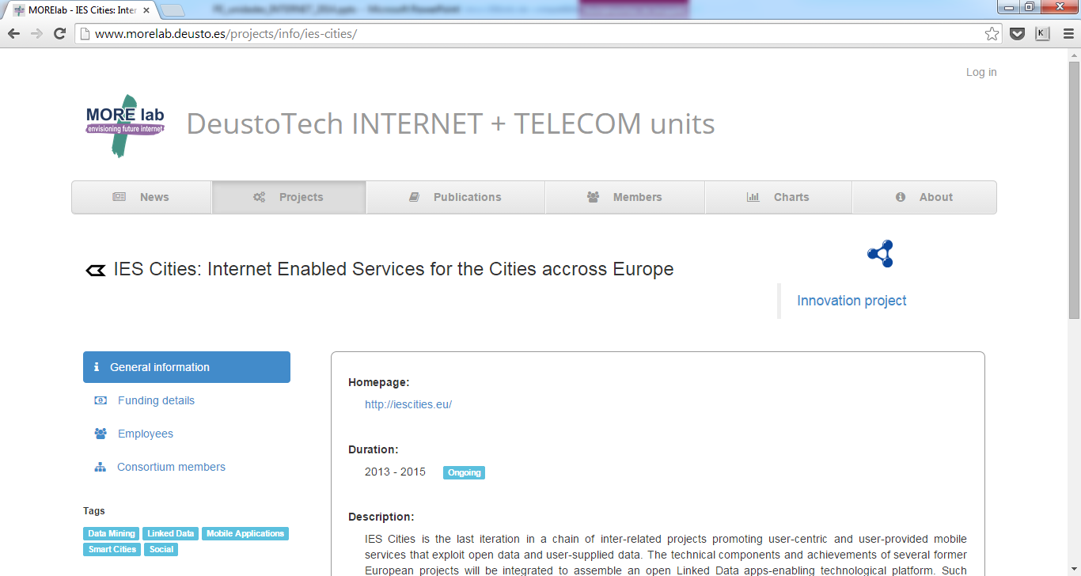
Web of Data: MORElab Group Dataset

Slide 38
Converting to and Visualizing Open Data
euwomen: visualization about women politician and voters in EU elections:
http://apps.morelab.deusto.es/euwomen/
euro e-lecciones, social data mining in Twitter to visualize trends for the last European elections
http://apps.morelab.deusto.es/eu_elections
teseo, conversion and visualization of the distribution by genre and topics of PhD dissertations in Spain. These data was extracted from site https://www.educacion.gob.es/teseo/irGestionarConsulta.do
http://apps.morelab.deusto.es/teseo
Dbpedia.eu, we are maintainers of DBPedia in Basque language
http://eu.dbpedia.org
intellidata, bank transaction analysis in different streets and neighborhoods in Madrid and Barcelona
http://apps.morelab.deusto.es/intellidata/

Slide 39
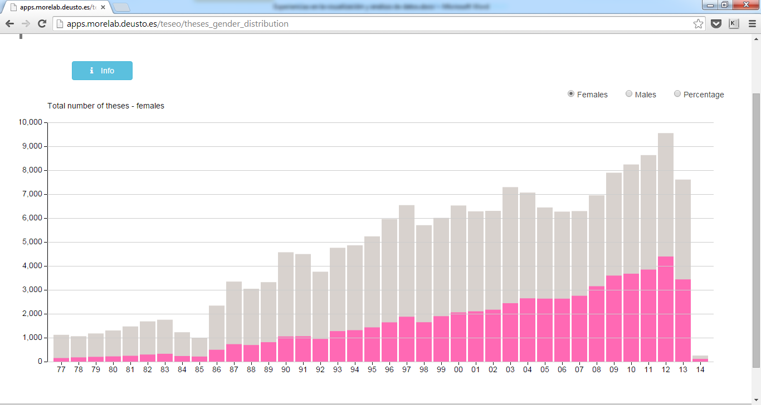
Converting to and Visualizing Open Data

Slide 40
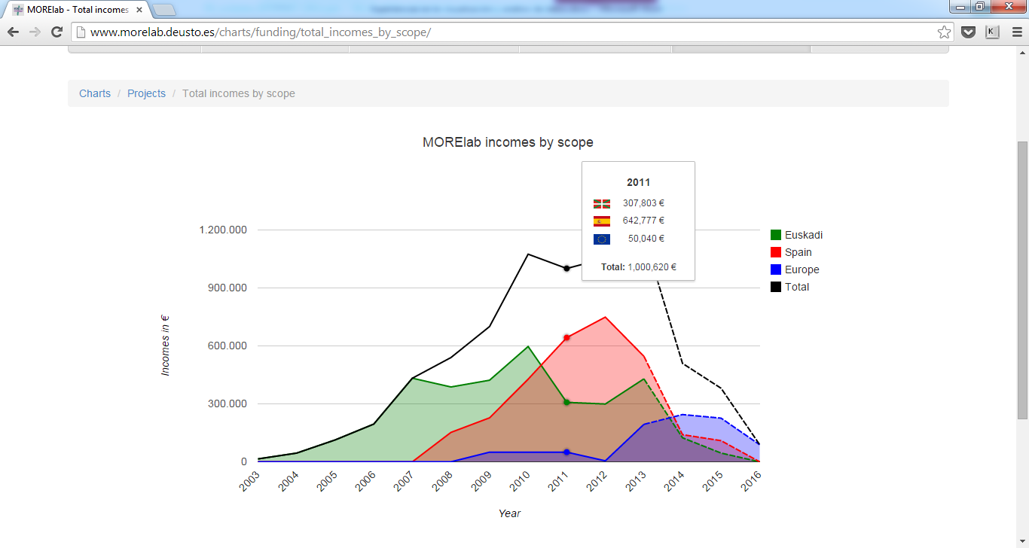
Converting to and Visualizing Open Data

Slide 41
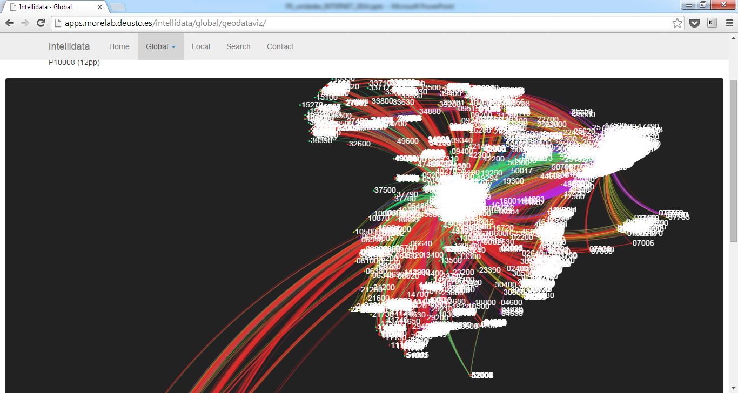
Converting to and Visualizing Open Data

Slide 42
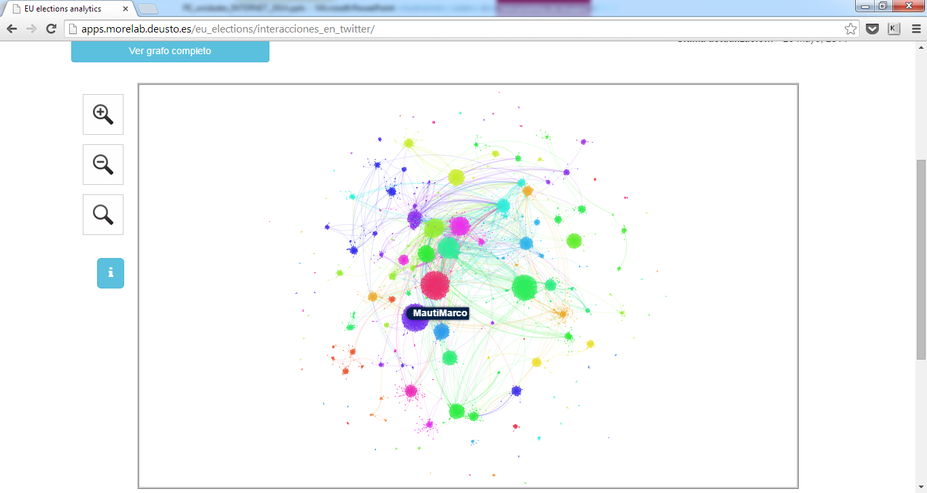
Converting to and Visualizing Open Data

Slide 43
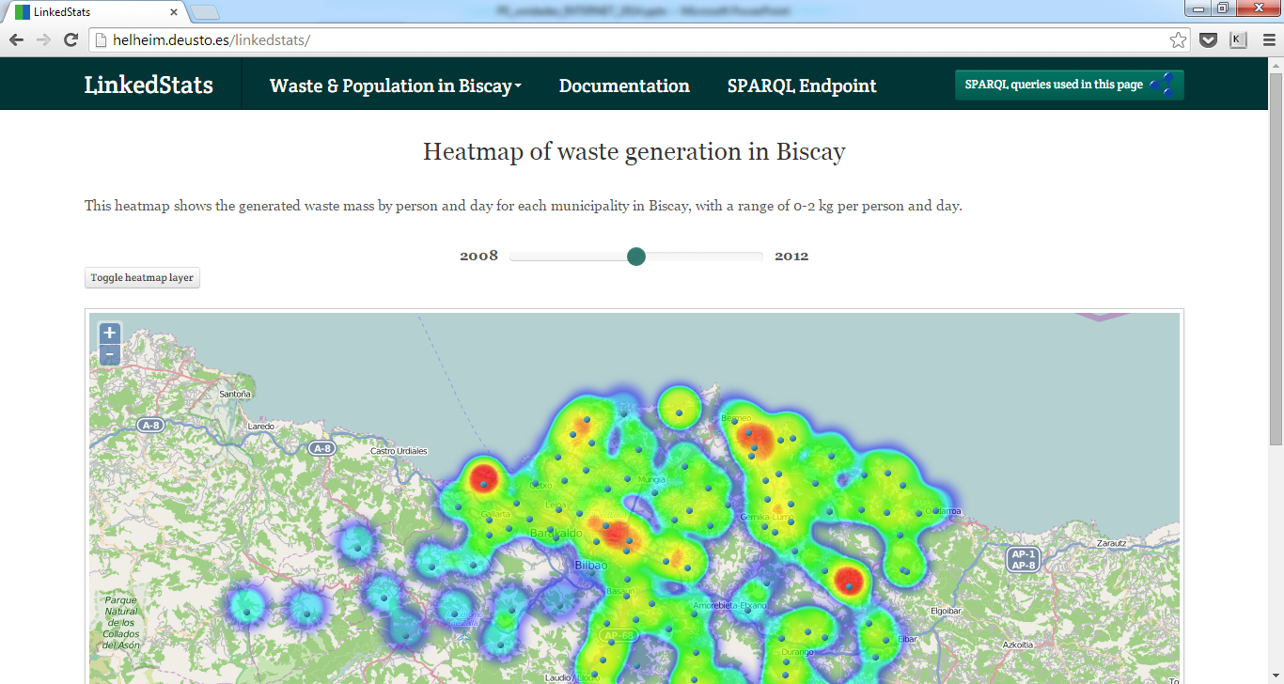
Converting to and Visualizing Open Data

Slide 44
Algunas contribuciones del equipo
Open source contributions:
Imhotep framework (Apache license): http://www.morelab.deusto.es/imhotep/
WebLabDeusto – https://www.weblab.deusto.es/web/
Otsopack – http://code.google.com/p/otsopack/
Zxing – databar – http://code.google.com/p/zxing/
labman_ud research group management system – https://github.com/OscarPDR/labman_ud
Open dataset released in CKAN about MORElab’s people, projects and publications:
http://ckan.linkeddata.es/dataset/morelab
Our datasets are scheduled to appear in next http://lod-cloud.net/
Organización del Open Data Day desde 2011
Ya está en preparación la de este año: http://opendataday.deusto.es
Organización de varios Open Hack Days or Random Hacks of Kindness

Slide 45
Ofertas de Trabajo
Pre-Doc en Interplay of Machine Intelligence and Wisdom of the Crowd to democratize and optimize consumption of Internet-based processes (more details on call https://t.co/hvwArQQq9Z):
Posición: https://t.co/PVw7dl9tAg
Call for competent software engineers:
https://t.co/oF5WTCmYi3

Slide 46
Enabling Smarter Cities through Internet of Things, Web of Data & Citizen Participation 17 de Febrero de 2016 Dr. Diego López-de-Ipiña González-de-Artaza dipina@deusto.es http://paginaspersonales.deusto.es/dipina http://www.morelab.deusto.es

